Slide 1

Youth Programs

Slide 2

4th of July parade
Flag replacements (Memorial & Veteran’s Day)
Holidays
Care packages

Slide 3
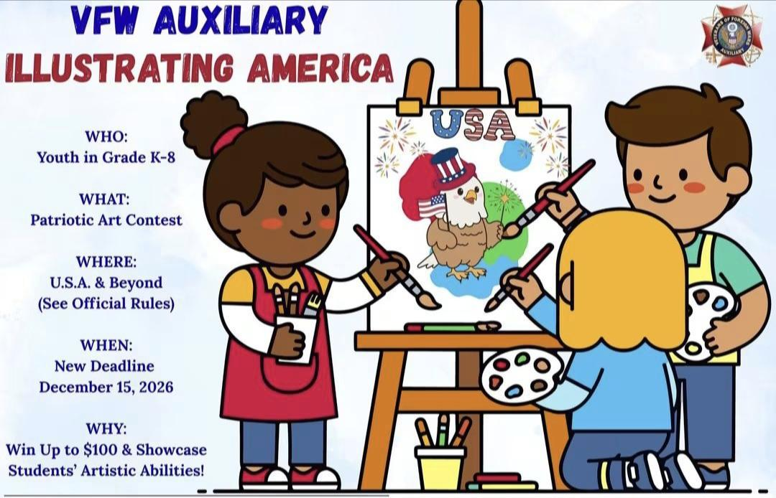
Public schools
Private schools
Home schooled

Slide 4
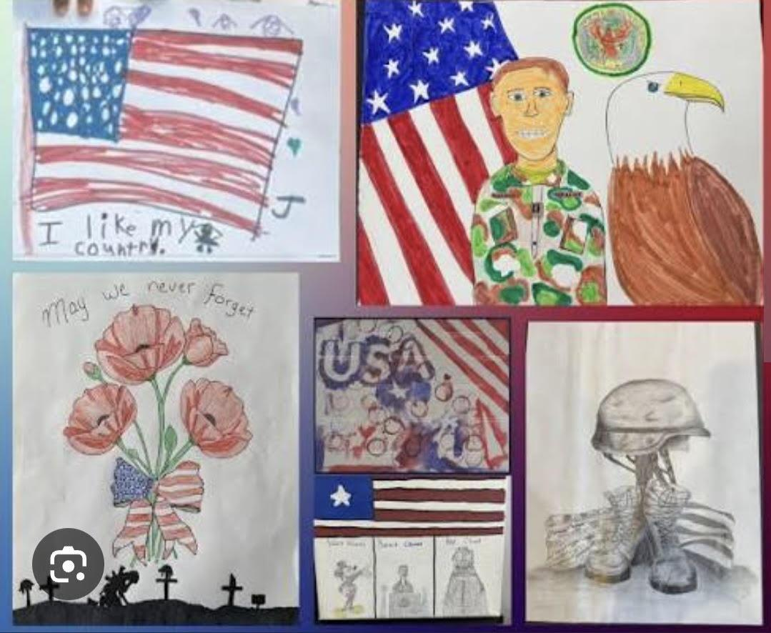
Let your imagination inspire America!
Create an original work of art that shows what America means to you
History
Freedoms
Traditions

Slide 5

Lending Library
Read to students
Patriotism Through Literacy
Read out loud events
Read with a Vet
Read-a-Thons

Slide 6

Awards at all levels
Post, District, State & National
Grade tiers
  K-2
  3-5
  6-8

Slide 7

Questions
10 points per question
What is the theme for illustrating America?
The deadline has been moved to what day?
Give one activity Auxiliary can include youth in.
What was one example given to grow the love of reading?
Where can official rules & eligibility for IA be found?

Slide 8

Answers
Show us how you see America
December 15th 2026 due to local VFW Auxiliary
Any bullet point from slide #2
Any bullet point from slide #5
In MALTA under Member Resources

