Slide 1

Veterans and Family Support Program
VFW Auxiliary, Department of New Mexico
September 19, 2026

Slide 2
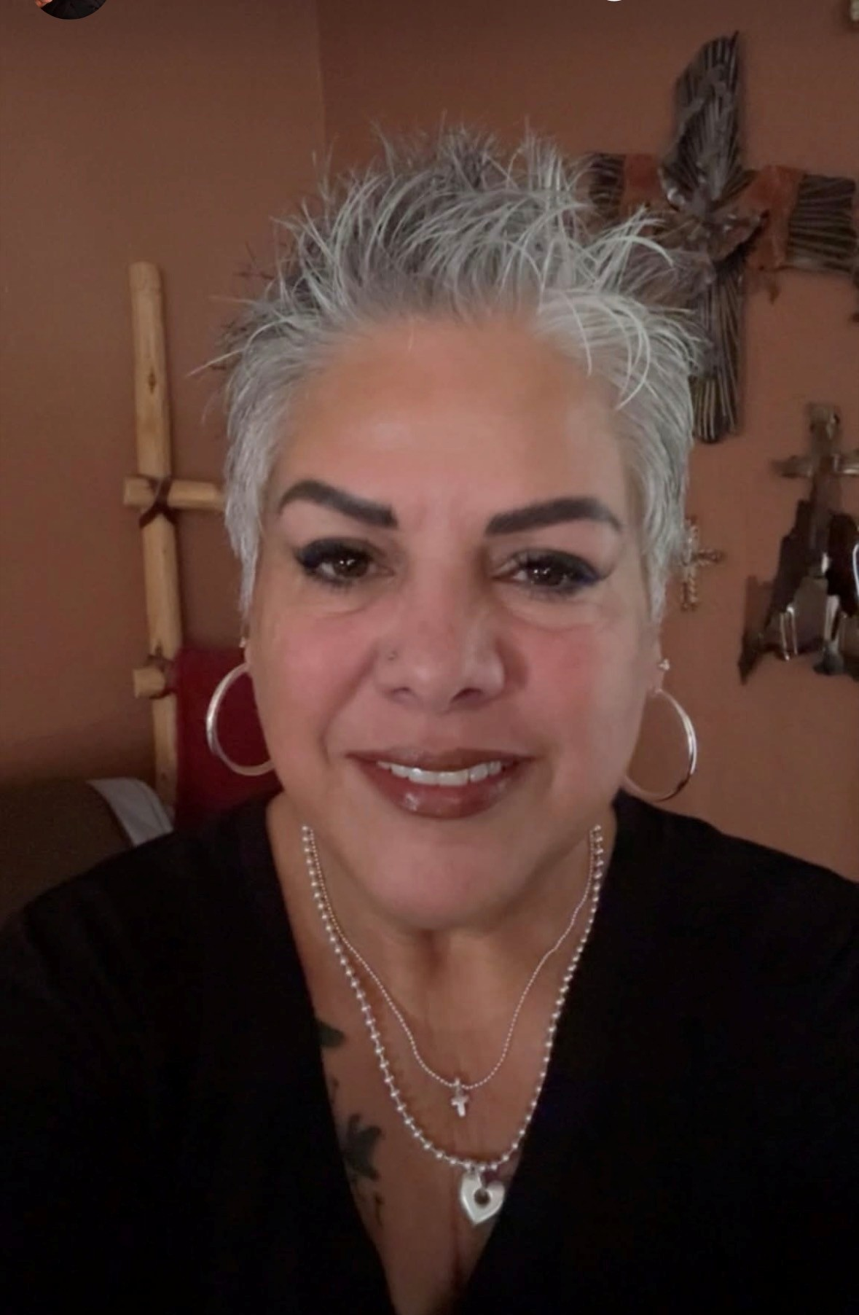
Beth West
National
Veterans & Family Support
Ambassador
2026-2027
Jonetta Martinez-Pacias
Dept. of NM
Veterans & Family Support
Chairman
2026-2027

Slide 3
The Veterans and Family Support Program:
Offers support for veterans, service members and their families
Promotes Veteran and Military Suicide Awareness and Prevention
Promotes VFW’s National Veterans Service (NVS)
Promotes VFW’s Veterans & Military Support Programs

Slide 4
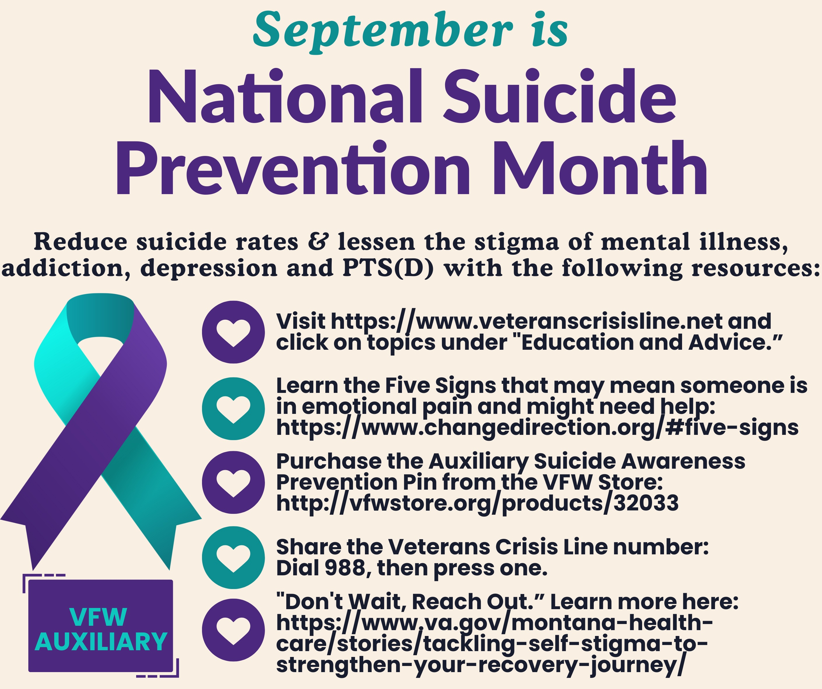


5 signs to look for when someone is in emotional pain and may need help:
Personality changes
Agitation
Withdrawal
Poor self-care
Hopelessness

Slide 5
How can you and your Auxiliary support Veterans and Families?
Support veterans in VA facilities
Assist veterans with everyday needs
Support military families
Help caregivers
Support homeless veterans
Offer scholarships and youth programs
Build connection and community
Connect people with professional resources
Recognize military service
Respond to individual needs
A simple Auxiliary service model:
Notice a need → listen → connect → assist → follow up

Slide 6
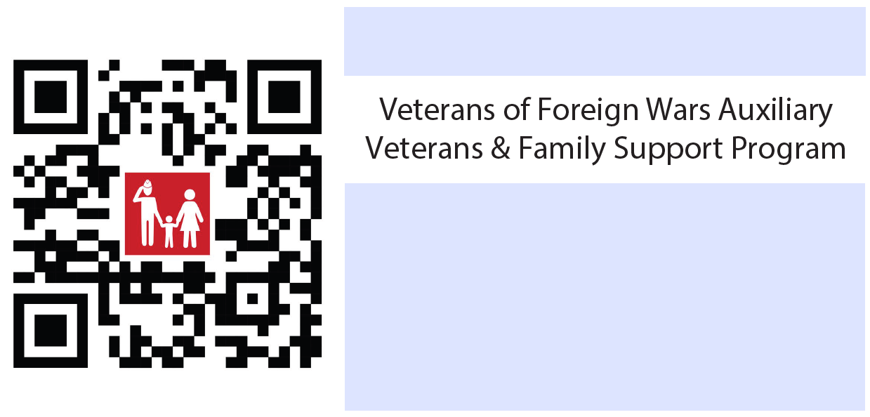
“It’s often the smallest acts of kindness that create the biggest differences.”

