Slide 1

2026-2027
Membership Program
Recruit-Retain-Rejoin
Engagement

Slide 2
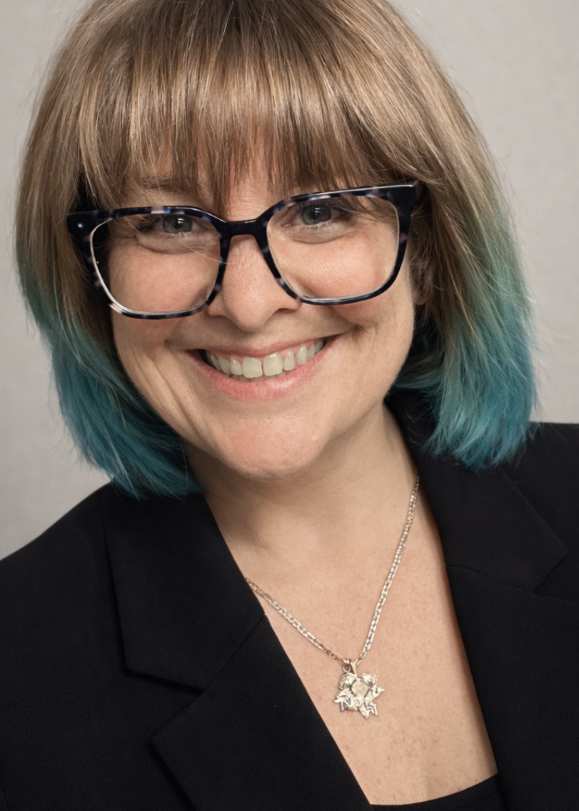

National Ambassador
Kristin DiGiacomo
Department of Pennsylvania
Department Chairman
Amanda Silva
Auxiliary 3370
505-903-1540
mandaztm@gmail.com

Slide 3
The Three R’s
Recruit
Retain
Rejoin
Then what?

Slide 4
Membership Engagement
What is their why?
What are their strengths?
ALWAYS be KIND, COURTEOUS, and LISTEN!

Slide 5

MEMBERSHIP BINGO!

Slide 6

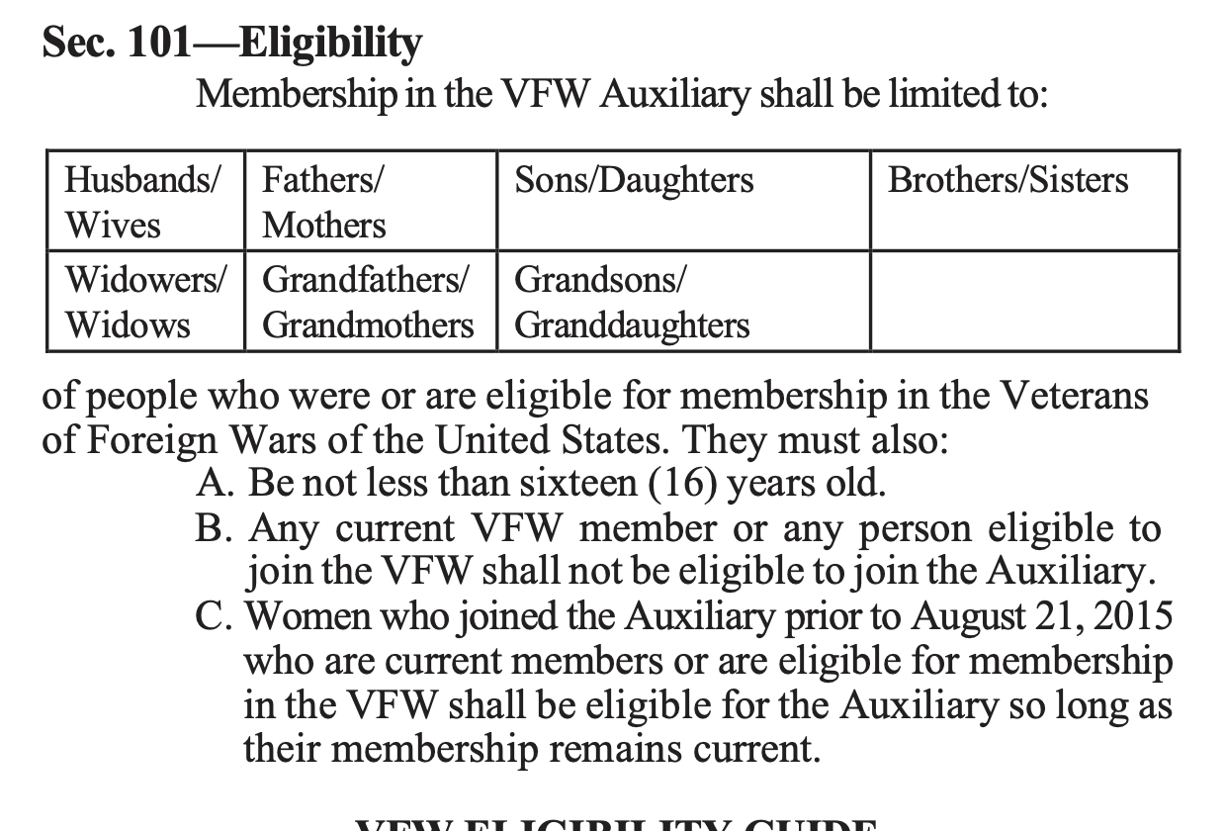
Eligibility

Slide 7
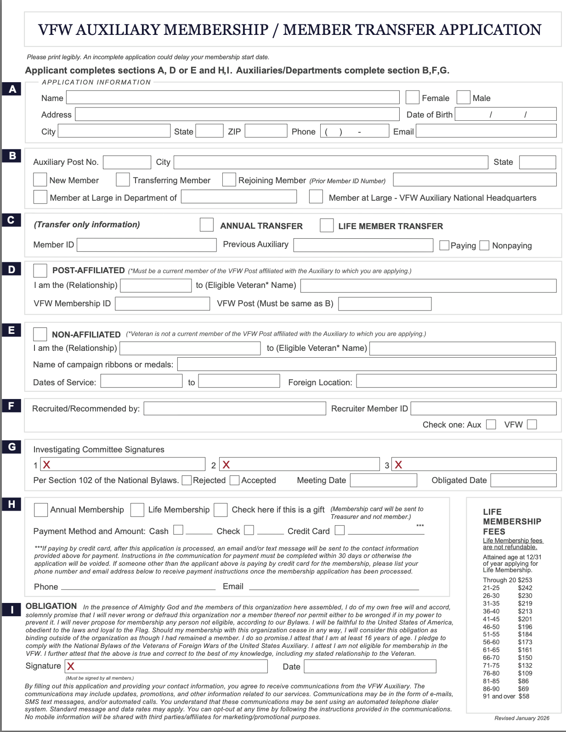
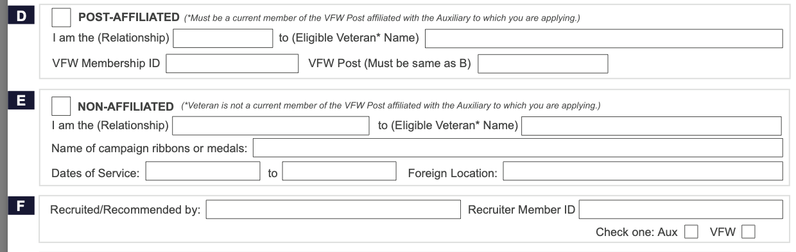
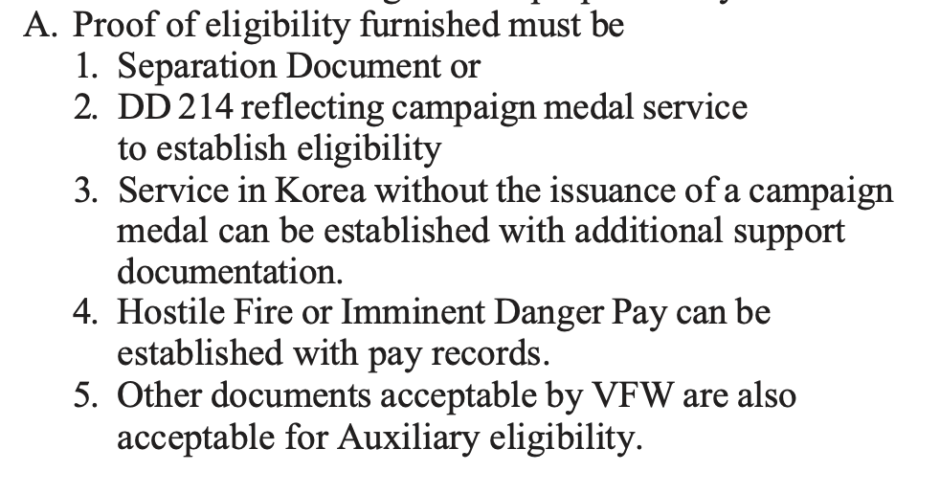
What to look for?

Slide 8

Awards
Awards for members:
5 Member Recruiter Pin – mailed to members and will be entered in a drawing to win $100 Visa gift card
Members who recruit 20+ New or Rejoined members will receive the National Membership Recruiter Award and will be entered in a drawing to win $400 Visa gift card
Department Awards:
1st Down – $400 to each Dept that reaches 95% by 11/30/2026
2nd Down – $450 to each Dept that reaches 98% by 2/28/2027
3rd Down – $500 to each Dept that reaches 100% by 4/30/2027
4th Down – $600 to each Dept that reaches 102% by 5/31/2027
Department Awards have since been DOUBLED by Convention Sponsor AMBA

