Slide 1
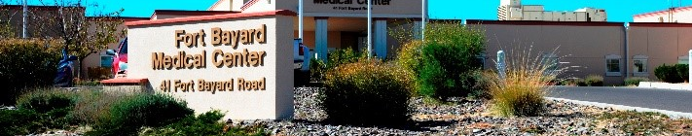
HOSPITAL
Promotes members to volunteer in local nursing homes and VA medical centers. It is one of the major programs in the VFW.

Slide 2
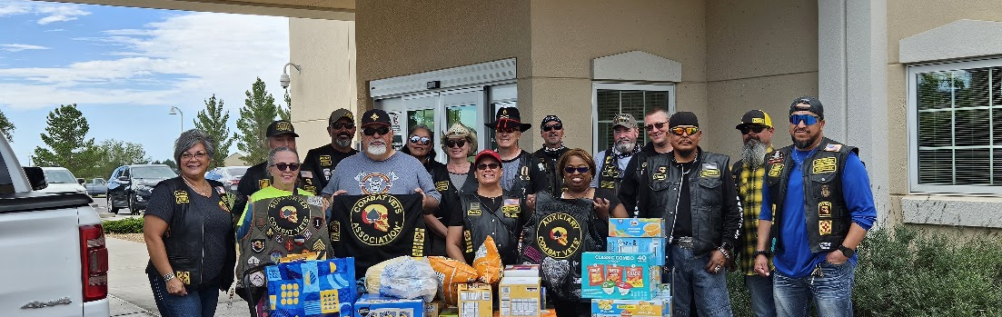
Coordinates volunteers to support hospitalized and recovering veterans in medical facilities
CVMA’s have been a big donator to Ft. Bayard every year.

Slide 3
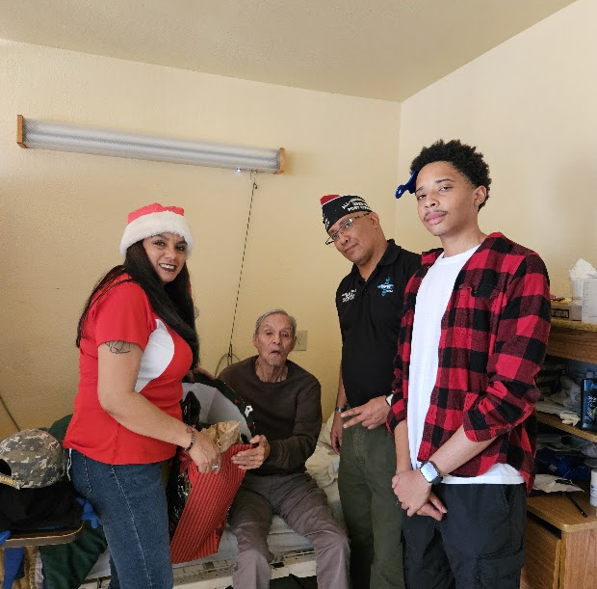
The Hospital Program also includes volunteering at VA Medical Centers, facilities or with patients.
By delivering Christmas gifts and visiting with the Veterans, helps to brighten their day.
Most Veteran’s do not receive any visits during the holidays.

Slide 4
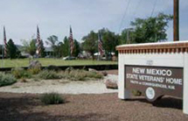
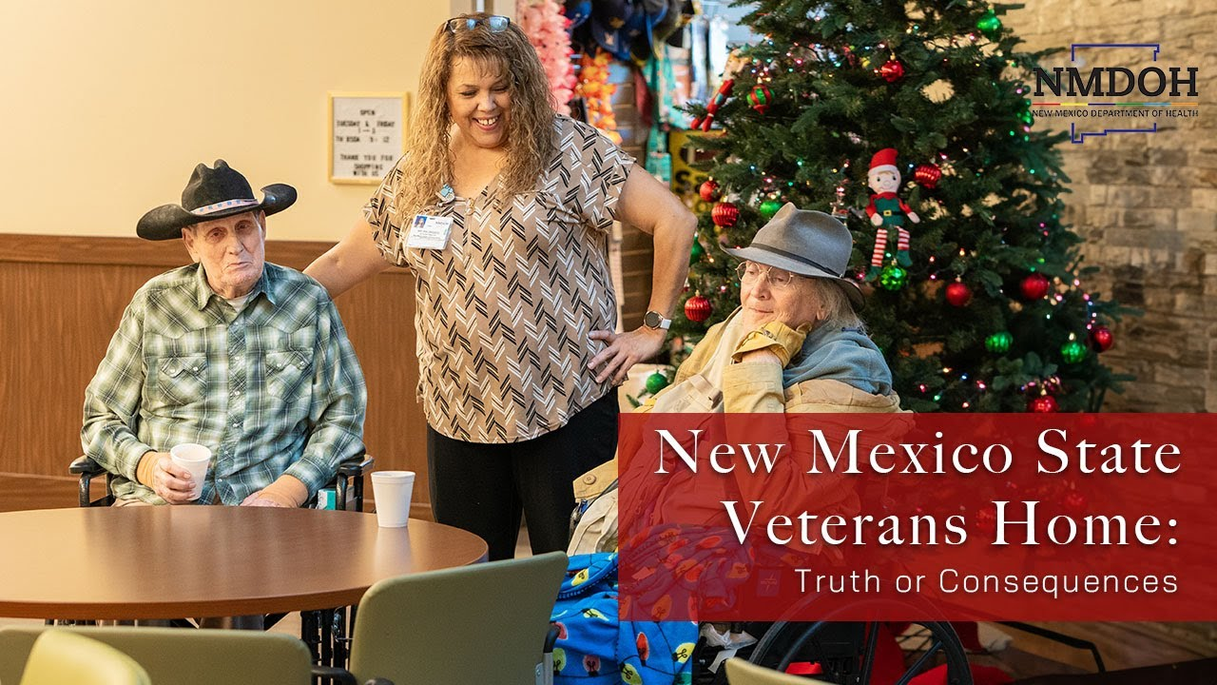
New Mexico State Veterans Home
T or C

Slide 5

Rooms
Ft. Bayard offers 40 rooms specialized for veterans and their spouses.
Currently only 36 are occupied.
Currently 2 spouses reside with veteran patients.
New Mexico State Veterans Home offers 131-135 beds.
12 Private rooms
There could possible be up to 4 patients in a room.

Slide 6

Questions
Does the Veterans Hospital charge a fee?
When would be a good time to visit the Veterans?
How many beds does Ft. Bayard have for Veterans?

Slide 7


Answers
Depends heavily on the veteran’s service-connected disability rating or roughly $0 - $7000 a month.
Any holiday is a good time, but Christmas and Veteran’s Day would be best.
They have 40 beds for veterans and there are 36 being occupied right now.

